Slide 1

IDDIC 2026 · AI & INNOVATION
DAY 3
Test before building.
DELIVERABLE OF THE DAY — M3 · TESTED HYPOTHESES & CONSOLIDATED VALUE
IDDIC 2026 · BREAKING AI

Slide 2

DAY 3
THE THREAD OF THE DAY
What you produce today
1
The hypotheses to test
Turn your hunches into bets that can be verified.
2
The test protocol
+ AT THE END OF THE DAY
A scenario, a mission, points to observe — without influencing.
The AI Journal
3
The wireframes
Your screens to sketch in the Wireframes notebook (separate file).
Prototyping is where AI becomes tempting. Note where you use it to test, generate, or decide — and what surprises you.
4
The test summary
What worked, what got stuck, what we keep.
5
Value proposition + who pays
Evolve the value, and raise the question of the business model.
IDDIC 2026 · BREAKING AI

Slide 3
DAY 3
TEMPLATE 1 / 5
The hypotheses to test
A good hypothesis is a precise bet. You can be wrong or right.
THE SHAPE OF A TESTABLE BET — “We bet that … . If it's true, we should see … . We'll know we were wrong if … .”
H1
We bet that…
H2
We bet that…
H3
We bet that…
H4
We bet that…
IDDIC 2026 · BREAKING AI

Slide 4
DAY 3
TEMPLATE 2 / 5
The test protocol
We tell the tester a story, give them a mission, and observe — without hinting at the answer.
① WHAT WE WANT TO VERIFY
④ WHAT WE MUST NEVER SAY
The precise hypothesis this test puts to the test.
What would steer them. We let them work it out to see what they understand on their own.
② THE SCENARIO — WE SET THE SCENE
“Imagine you are … / You absolutely want to … / Your mission: look at these screens and try to … ”
③ CHECKPOINT A
③ CHECKPOINT B
I watch whether their action is indeed …
I watch whether they understand the difference between…
IDDIC 2026 · BREAKING AI

Slide 5
DAY 3
TEMPLATE 3 / 5
The test summary
A “failed” test that teaches you something is a successful test.
What worked / was liked
What got stuck
VALIDATED hypotheses
H1
H2
H3
H4
NON-validated hypotheses
H1
H2
H3
H4
The questions we're asking ourselves
Our ideas for the next proto
IDDIC 2026 · BREAKING AI

Slide 6
DAY 3
TEMPLATE 4 / 5
Value proposition: before → after
The tests may have shifted your value proposition.
OUR VALUE PROPOSITION (END OF D2)
WHAT THE TESTS CHANGED
OUR CONSOLIDATED VALUE PROPOSITION
→
→
WHO WILL PAY? AND WHY WOULD THEY AGREE TO PAY?
It's not always the user. Sometimes it's the school, the company, a brand… The answer prepares your Business Model Canvas for the intersession.
IDDIC 2026 · BREAKING AI

Slide 7
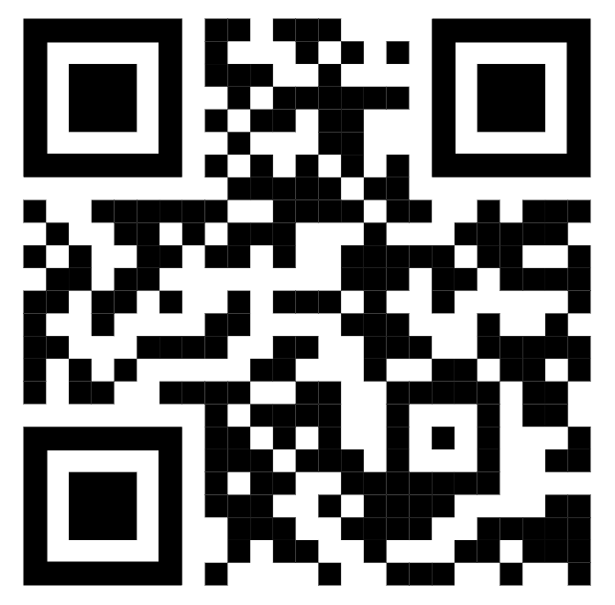
DAY 3
The AI Journal
This is not about assessing your use of AI, but observing how AI concretely influences your work and helping you step back and reflect on that use.
IDDIC 2026 · BREAKING AI

