Slide 1

IDDIC 2026 · AI & INNOVATION
DAY 2
Listen to the field. Understand the need.
DELIVERABLE OF THE DAY — M2 · VALIDATED NEEDS & VALUE PROPOSITION
IDDIC 2026 · BREAKING AI

Slide 2

DAY 2
THE THREAD OF THE DAY
What you produce today
1
The art of the good question
Ask open questions, grounded in lived experience, without hinting at the answer.
2
Gathering verbatims
+ AT THE END OF THE DAY
Capture the exact phrases — and the question that drew them out.
The AI Journal
3
From verbatim to need
Move from what people say to what they truly need.
The team notes how it did (or didn't) use AI during the day and what surprised it. Without judgement.
4
Your 3 personas
Put a face to those you met.
5
Refined problem statement + value proposition
Reframe the question, and say what your solution would change.
IDDIC 2026 · BREAKING AI

Slide 3
DAY 2
TEMPLATE 1 / 6
The art of the good question
Run about ten interviews
1
Open
OUR 3-4 OPENING QUESTIONS
“Tell me about the last time you…” rather than “Do you like…?” (which is answered yes/no).
Test them among yourselves before going into the field.
2
Grounded in lived experience
We dig into the real past, not intentions: “the last time”, “the time it went wrong”.
3
Without hinting at the solution
We propose nothing. We listen to the problem. The solution is your job later on.
WE TRANSFORM — “Would you use a carpooling app?” → “Tell me about your last nightmare journey.” Start from the real, not the product.
IDDIC 2026 · BREAKING AI

Slide 4
DAY 2
TEMPLATE 2 / 6
Gathering verbatims
THE QUESTION WE ASKED
THE VERBATIM (WORD FOR WORD, IN “ ”)
IDDIC 2026 · BREAKING AI

Slide 5
DAY 2
TEMPLATE 3 / 6
From verbatim to need
They say “I jot my ideas on sticky notes that I lose all the time.”
They say “In the evening I order food because I'm too wiped out to choose.”
→ Real need: to find one's ideas again with no filing effort — not “buy a notebook”.
→ Real need: to decide without mental fatigue — not “have more restaurants”.
They say: “… ”
→ The real need: …
They say: “… ”
→ The real need: …
They say: “… ”
→ The real need: …
They say: “… ”
→ The real need: …
IDDIC 2026 · BREAKING AI

Slide 6
DAY 2
TEMPLATE 4 / 6
A persona
Choose 3 stakeholders you met. One sheet per persona.
PHOTO
WHAT FRUSTRATES THEM (CONSTRAINTS, IRRITANTS)
WHO IS IT? (NAME, AGE, ROLE…)
Describe a real profile you met.
What annoys them, slows them down, irritates them day to day.
MOST STRIKING STORY OR VERBATIM
WHAT THEY CARE ABOUT (HOPES, DREAMS)
What they hope for, what really matters to them.
IDDIC 2026 · BREAKING AI

Slide 7
DAY 2
TEMPLATE 5 / 6
Refined problem statement & value proposition
The field has changed how you see things. Reframe the question — then say what your solution would change.
OUR STARTING PROBLEM STATEMENT (D1)
WHAT THE FIELD TAUGHT US
OUR REFINED PROBLEM STATEMENT
→
→
OUR VALUE PROPOSITION
OUR HUNCH FOR A SOLUTION (OPTIONAL)
For [this persona] who [this need], our solution brings [what change]. Unlike today, it [the difference].
You probably already have one in mind. Note it down — the coach is there to challenge it, not to validate it.
IDDIC 2026 · BREAKING AI

Slide 8
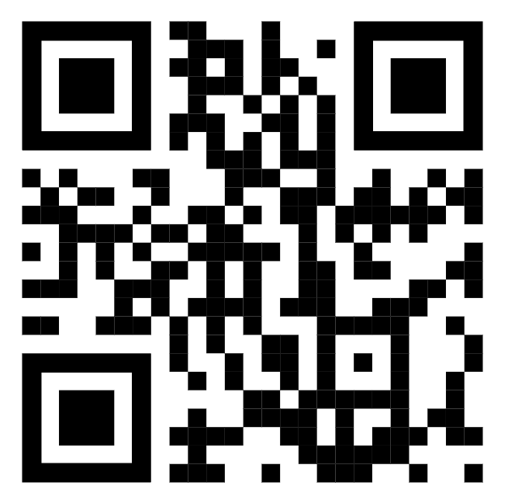
DAY 2
The AI Journal
This is not about assessing your use of AI, but observing how AI concretely influences your work and helping you step back and reflect on that use.
IDDIC 2026 · BREAKING AI

