Slide 1

IDDIC 2026 · AI & INNOVATION
DAY 1
Explore. Get moving
DELIVERABLE OF THE DAY — M1 · CONTEXTUALISED PROBLEM STATEMENT
IDDIC 2026 · BREAKING AI

Slide 2

DAY 1
THE THREAD OF THE DAY
What you produce today
1
Your question & your field
Choose a challenge, anchor it in a context, say why it speaks to you.
2
Are you the right people?
+ AT THE END OF THE DAY
The legitimacy test: who, on the team, can really go into this field?
The AI Journal
3
Stakeholder mapping
List everyone the problem affects — well beyond the two obvious ones.
The team notes how it did (or didn't) use AI during the day and what surprised it. Without judgement.
4
Getting started in the field
Your first contacts, and what you're trying to discover.
5
The mini action plan
Your next 3 steps. Not ten. We adapt as we go.
IDDIC 2026 · BREAKING AI

Slide 3
DAY 1
TEMPLATE 1 / 5
Problem statement
① THE CHALLENGE CHOSEN (FROM THE CATALOGUE)
② THE CONTEXT
Higher education
Business
Creative industry
③ PROBLEM STATEMENT REFRAMED IN OUR CONTEXT
④ WHY THIS QUESTION SPEAKS TO US
A problem statement lets you answer: What change are we seeking to bring about, and why does it matter?
What annoys you, intrigues you, moves you.
IDDIC 2026 · BREAKING AI

Slide 4
DAY 1
DAY 1
TEMPLATE 2 / 5
Are you the right people?
The goal of IDDIC is to bring you to implement a workable innovative solution. Exploring your problem must be done in an environment you can question.
WHO HAS A FOOT IN THIS WORLD?
WHO TO CALL BEFORE THE COACHING?
Work placement, job, family, association, passion…
2-3 people you can reach right now
IDDIC 2026 · BREAKING AI

Slide 5
DAY 1
TEMPLATE 3 / 5
Stakeholder mapping
Don't limit yourself to the first ideas that come… At least 8 different stakeholders. Below that, you haven't dug deep enough yet. The categories are a guide; you can imagine others. Take 10 minutes.
Who SUFFERS the problem?
Who DECIDES / holds the power?
Who PAYS / buys?
those first affected
e.g. the programme lead, management
e.g. whoever buys the AI subscriptions
Who INFLUENCES?
Who BENEFITS / could gain from it?
Who might HINDER / oppose it?
experts, prescribers, peers, unions…
beyond the obvious
those it disturbs
IDDIC 2026 · BREAKING AI

Slide 6
DAY 1
TEMPLATE 4 / 5
Getting started in the field
Don't imagine your users' daily lives — meet those reachable today and listen.
1.
Name / role — how to reach them (email, DM, in person…)
WHAT WE'RE TRYING TO UNDERSTAND
Which questions do you want to ask?
2.
Name / role — how to reach them (email, DM, in person…)
FIRST FEEDBACK
3.
Name / role — how to reach them (email, DM, in person…)
What did you take away from these exchanges?
IDDIC 2026 · BREAKING AI

Slide 7
DAY 1
DAY 1
TEMPLATE 5 / 5
The mini action plan
Concretely, what have you planned to do after the coaching to move your project forward.
1
Our 1st step
2
Our 2nd step
3
Our 3rd step
WHAT?
WHAT?
the concrete action
WHAT?
the concrete action
the concrete action
WHO?
WHO?
WHO?
WHEN?
WHEN?
WHEN?
A GOOD 1ST STEP is small, precise, doable right away. Challenge these mini-steps with your coach.
IDDIC 2026 · BREAKING AI

Slide 8

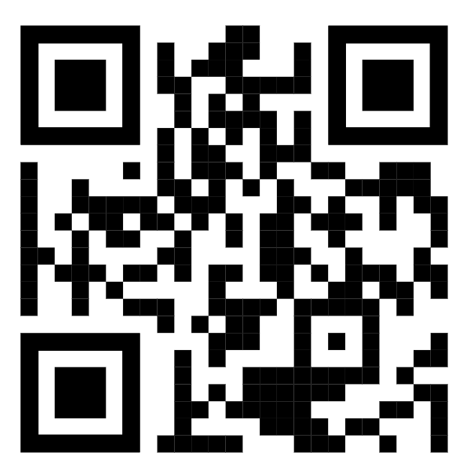
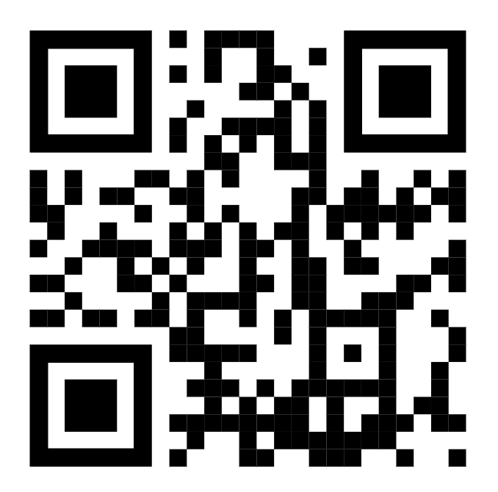
DAY 1
DAY 1
QUESTIONNAIRES
Two questionnaires must be completed at the end of Day 1
THE INDIVIDUAL QUESTIONNAIRE
The AI Journal - 1 response per team
To be filled in only once per student
This is not about assessing your use of AI, but observing how AI concretely influences your work and helping you step back and reflect on that use.
NOTE DOWN YOUR TRACKING NUMBER.
IT WILL BE NEEDED AT THE END OF IDDIC
IDDIC 2026 · BREAKING AI

